Slide 1
MIT 3.071
Amorphous Materials
1: Fundamentals of the Amorphous State
Juejun (JJ) Hu
hujuejun@mit.edu

Slide 2
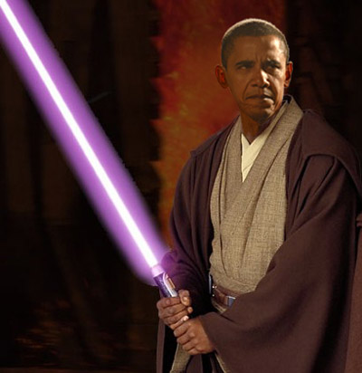
Contact Information
Juejun (JJ) Hu, Rm 13-4054
hujuejun@mit.edu
Ph: (302) 766-3083
Research interests
  We work with light
  Optics & photonics
  Novel optical materials (including amorphous materials)
  Optical sensing, imaging, communications, solar energy, and many other topics related to light

Slide 3
References
Fundamentals of Inorganic Glasses
  Arun Varshneya, Academic Press (1994)
  Arun Varshneya, John Mauro, Third Edition (2019)
  Google Books, Google Books
Introduction to Glass Science and Technology
  James E. Shelby, Royal Society of Chemistry (2005)
  RSC Publishing
Glass Science, 2nd Edition
  Robert H. Doremus, Wiley (1994)
Springer Handbook of Glass
  J. D. Musgraves, J. Hu, L. Calvez (Eds.), Springer (2020)

Slide 4
Class organization
Modules
  Lectures: MW 1-2:30
  In-class demos (including a joint session with the MIT Glass Lab)
  Individual project meetings
  Final project presentation
  Pick-your-own-topic lectures
Canvas site
  Announcements, lecture slides, assignments, and solutions will be posted online
  Spring 2024 Canvas Link

Slide 5


Pick-your-own-topic lectures
You pick the topic, and I present
  Submit your topic proposal by Apr. 15
  Topics must be relevant to amorphous materials
  Think about depth and breath
  If there are more topics proposed than lecture slots available, we will set up a voting system
JJ
You

Slide 6
Grading policy
Homework assignments: 30%
  Three PSets
  Discussions are allowed and encouraged; but you are supposed to complete the assignments independently
Design review project: 70%
  Project proposal: 20%
  Term paper: 30%
  Final presentation: 20%

Slide 7
Important dates
Mar. 20 project proposal due
  Page limit: 4 (including figures, tables, and references); Font: Times New Roman 12; Page format: letter size with 1 inch margin
  Motivation and significance; Brief review of state-of-the-art; Proposed technical approach; Anticipated outcome
  1 executive summary slide
May 8 project presentation
  Time limit and format: TBD

Slide 8
Important dates
May 13 term paper due
  Page limit: 8 (including figures, tables, and references); Font: Times New Roman 12; Page format: letter size with 1 inch margin
  Motivation and significance; Current state-of-the-art; Research methodology; Results and discussion; Conclusions
Document templates are posted on Canvas

Slide 9
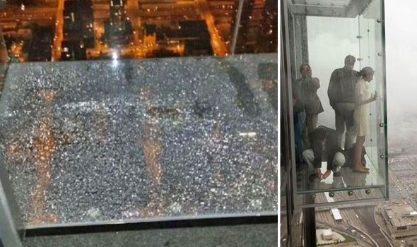
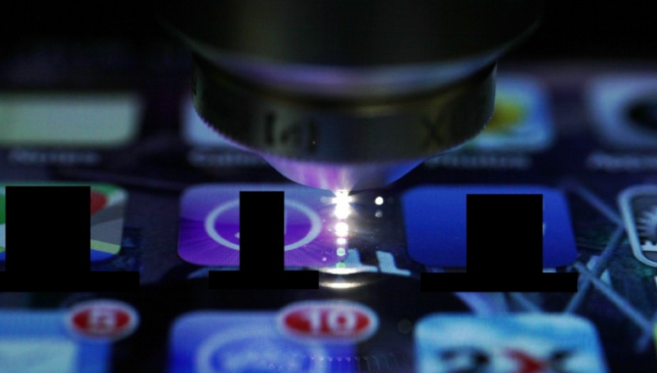
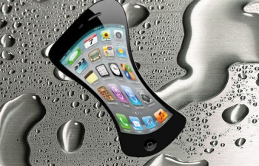
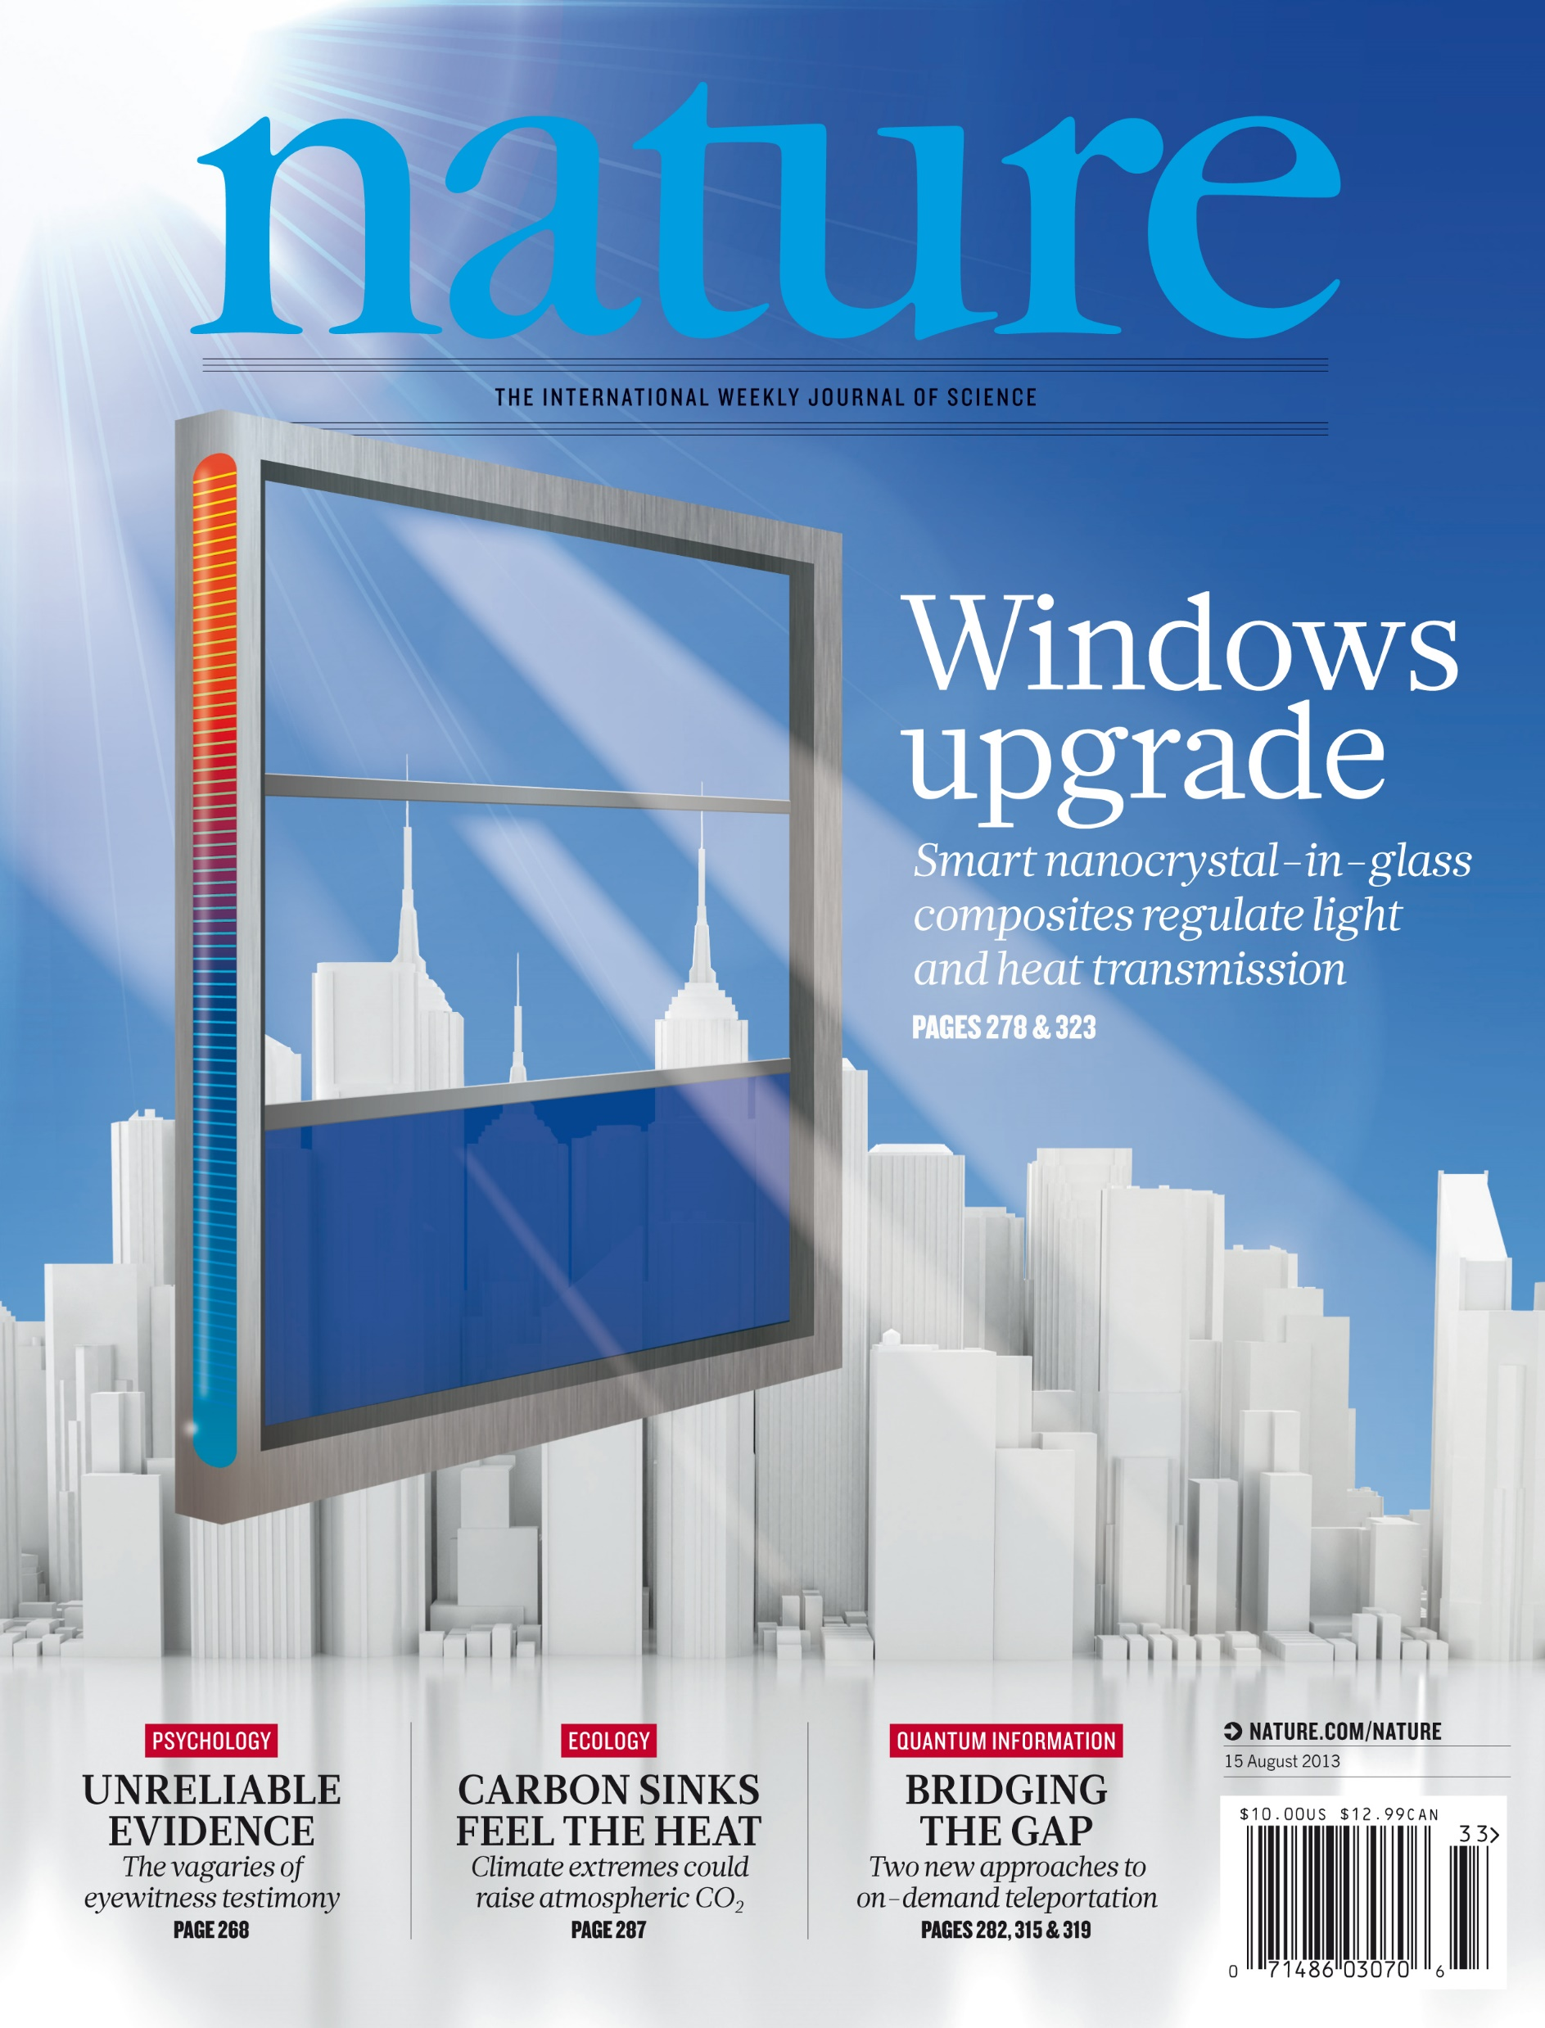
Project topic examples
Glass box cracks at 1,353 feet above: is it still safe?
Can we make smart phones smarter with built-in photonics?
Opt. Express 22, 15473 (2014)
Are smart windows technologically and economically viable?
Where is my metallic glass cased iPhone?

Slide 10
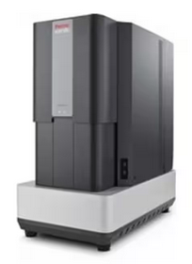
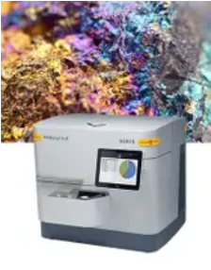
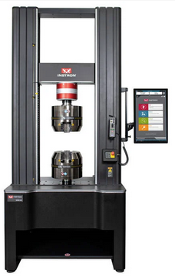
DMSE Breaker Space
https://dmse.mit.edu/education/dmse-breakerspace/
Material exploration and characterization lab allowing undergrads direct access to powerful instruments, including…
Desktop Scanning Electron Microscope
Benchtop X-ray
Diffractometer
Tensile, Compression, and Flexure Testing

Slide 11
Evaluation criteria
Proposals and papers
  Intellectual merits (75%): soundness, depth, thoroughness, inventiveness
  Presentation (25%): logical coherence, clarity, conciseness
In-class presentation
  Timing (20%)
  Presentation (40%): logical coherence, clarity, conciseness
  Intellectual merits (40%): soundness, depth, thoroughness, inventiveness

Slide 12
What is glass (amorphous solid)?
Solid matter
Amorphous solid
Glass
Silicate glass
“Glass” as we known it everyday

Slide 13
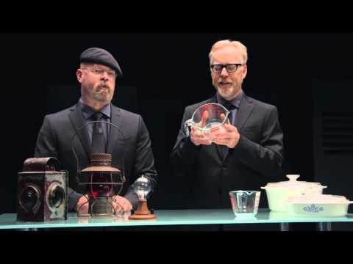

Slide 14
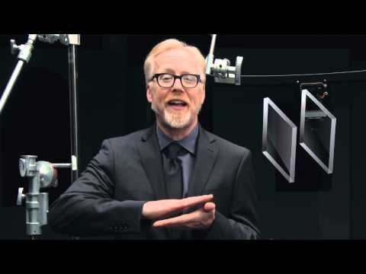

Slide 15
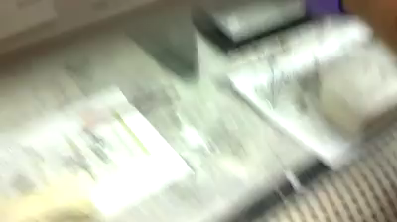

What is glass (amorphous solid)?
Mechanical properties
  Brittle, fragile, stiff
Optical properties
  Transparent, translucent
“A room-temperature malleable glass” (As₆₀Se₄₀)
Video courtesy of IRradiance Glass Inc.

Slide 16
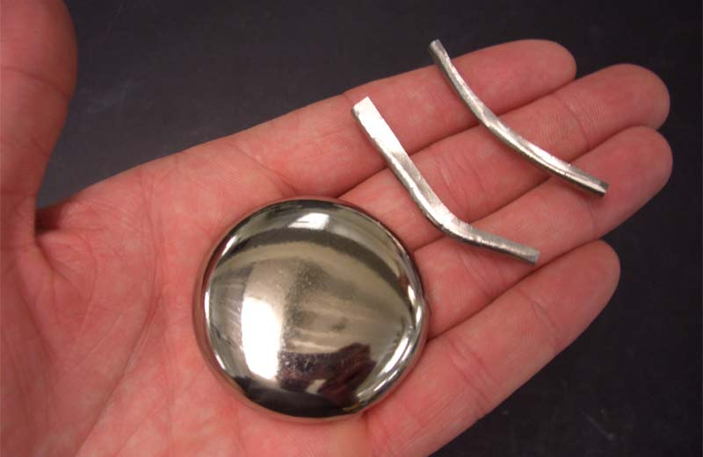
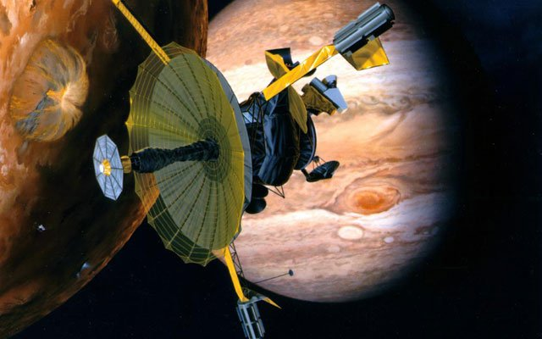

What is glass (amorphous solid)?
Electrical properties
  Insulating
Chemical properties
  Durable, inert
Metallic glass
Man-made
  Obsidian (volcanic activity)
  Tektite (meteorite impact)
  Fulgurite (lightning strike)
NASA: Galileo Spacecraft found amorphous ice on moons of Jupiter

Slide 17
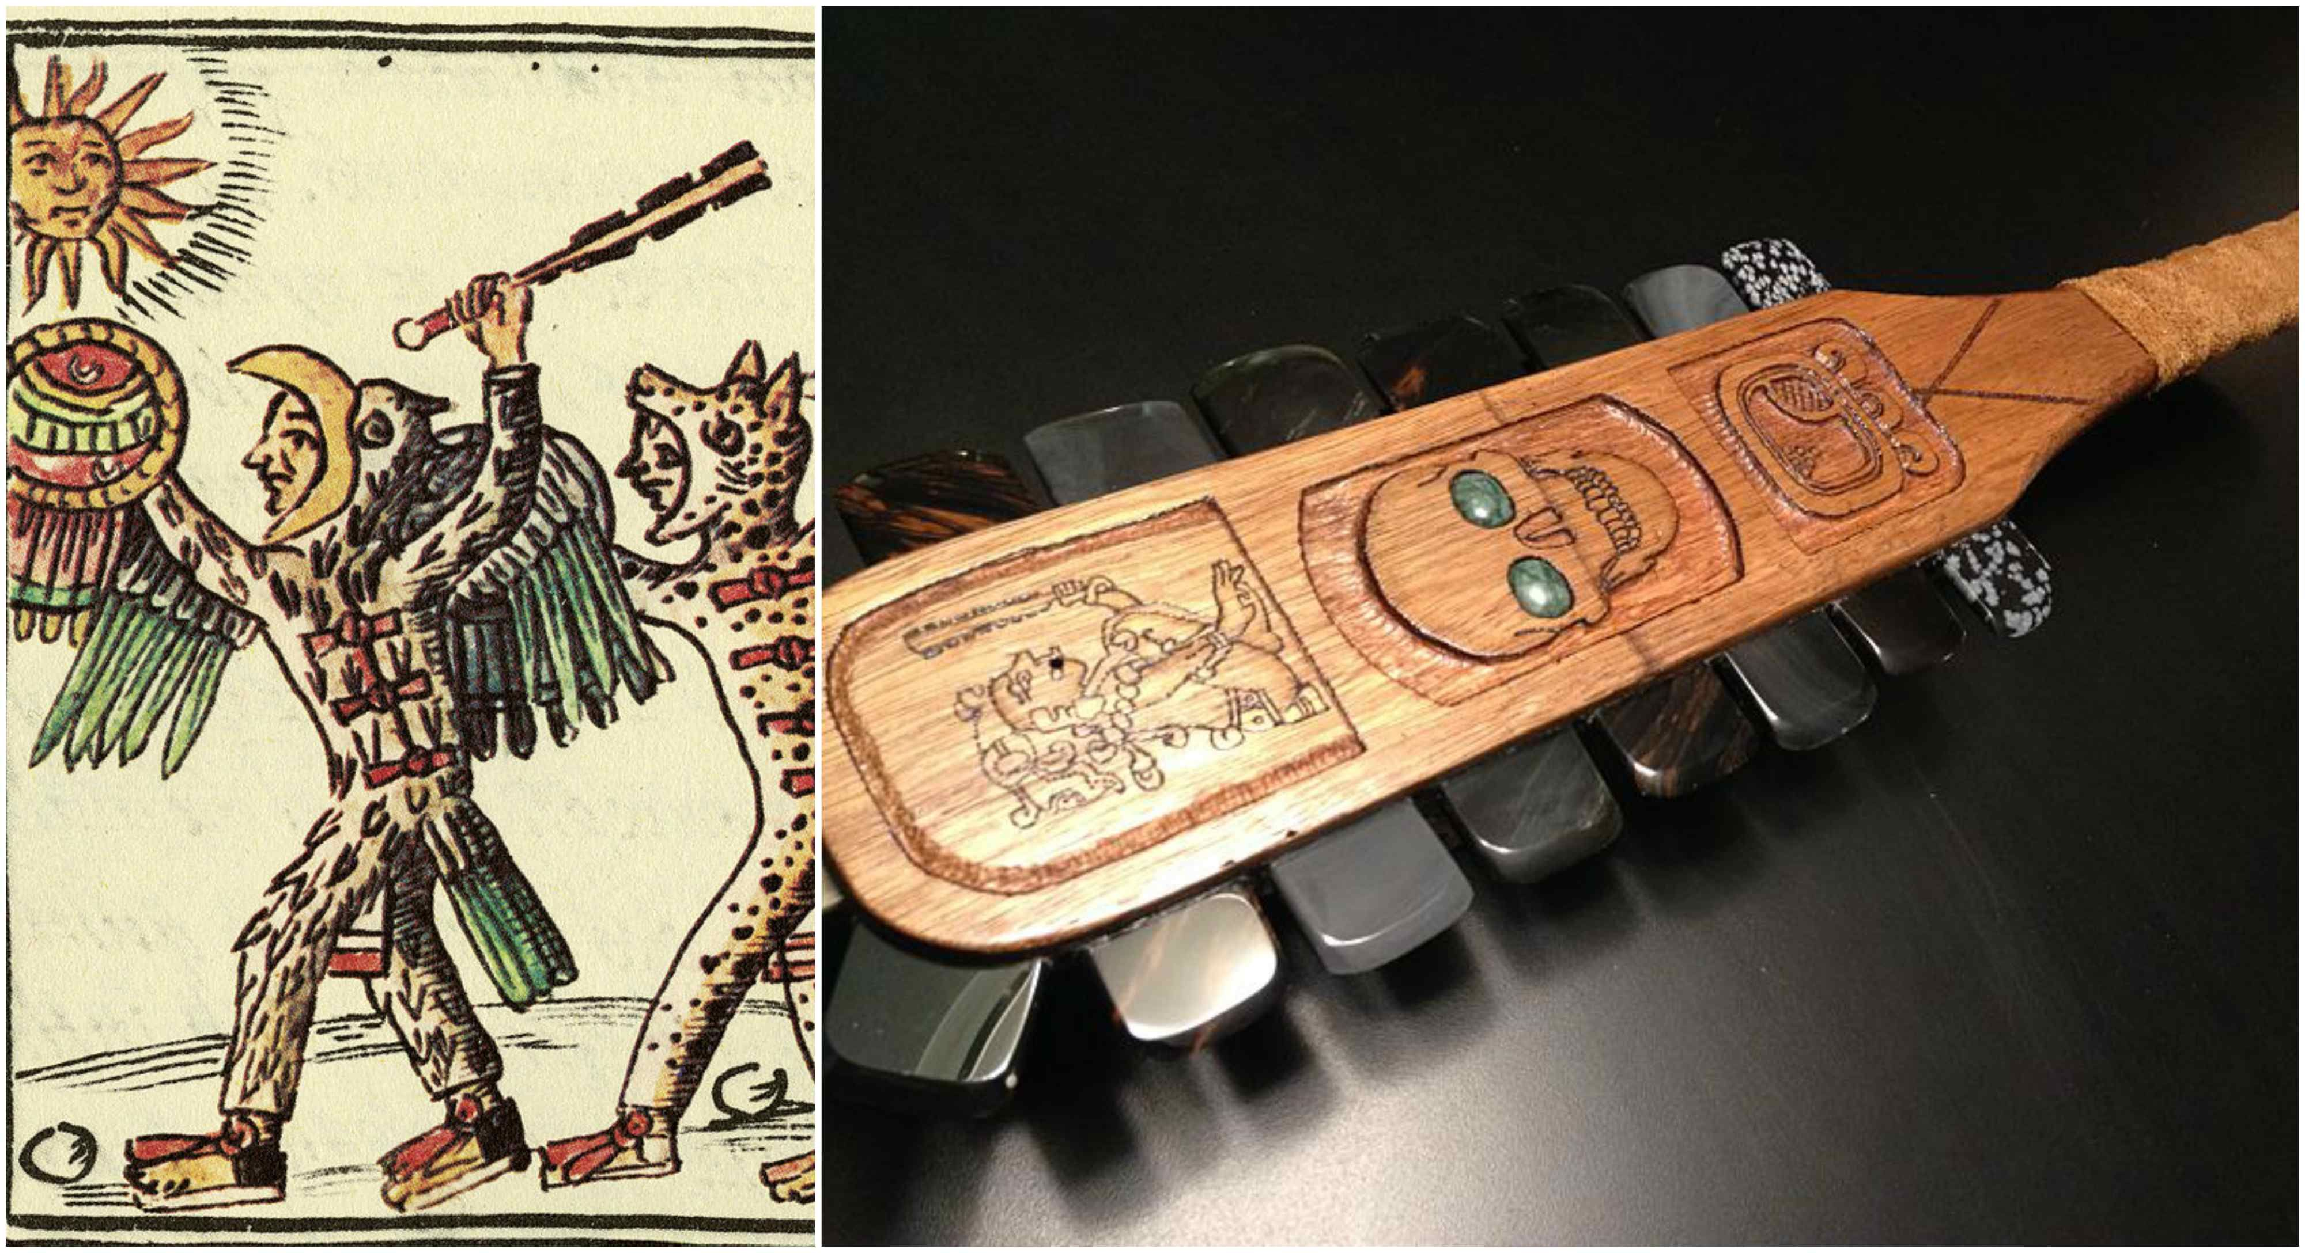
The stone age… or the glass age?
“Obsidian is capable of producing an edge sharper than high quality steel razor blades…. What need could there be for a replacement material? The Aztecs didn't develop their use of metal because they couldn't see beyond obsidian.”
An Obsession with Obsidian

Slide 18
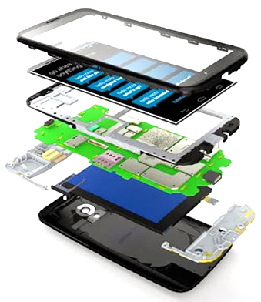
Amorphous materials are ubiquitous
Glass cover
Camera lens
TFT display
Dielectrics
Circuit packaging
Metallic glass case
Phase change memory
Solid state battery
and many more…

Slide 19
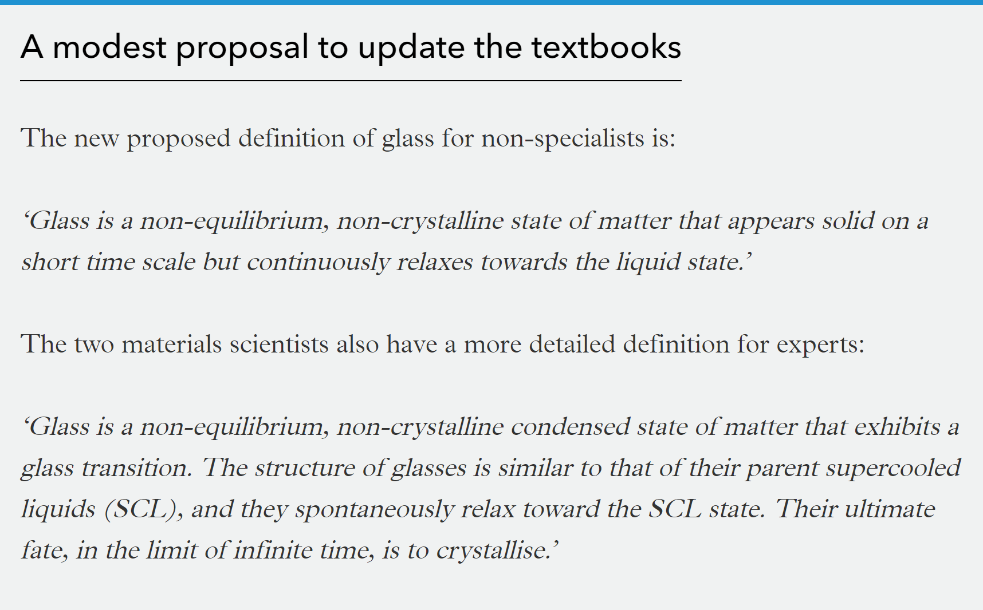
“The glassy state of matter: Its definition and ultimate fate,” J. Non-Cryst. Solids 471, 490 (2017)
Notes:
Above T_{KS} the average relaxation time of the SCL is shorter than the average crystal nucleation time, whereas for T < T_{KS} the average nucleation time is shorter than the average relaxation time. Here T_{KS} is the kinetic spinodal temperature. See Mauro et al. JNCS 2017.

Slide 20
What is amorphous solid (glass)?
Solid matter
Amorphous solid
A metastable solid with no long-range atomic order
Glass
A metastable solid with no long-range atomic order and exhibiting a glass transition
Silicate glass
glass based on SiO₂
“Glass” as we known it everyday

Slide 21
What is amorphous solid (glass)?
A metastable solid with no long-range atomic order (and exhibiting glass transition)
metastable
E
Metastable glassy state
Thermodynamically stable crystalline state
Glasses are metastable with respect to their stable crystalline phase
Atoms can rearrange to form a more stable state given enough time and thermal energy
Structure

Slide 22
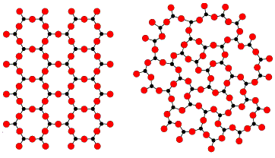
What is amorphous solid (glass)?
A metastable solid with no long-range atomic order (and exhibiting glass transition)
no long-range atomic order
Short-range order is preserved (AO₃ triangles)
Long-range order is disrupted by changing bond angle (mainly) and bond length
Structure lacks symmetry and is usually isotropic
Consider a fictitious A₂O₃ 2-D compound:
A₂O₃ crystal
A₂O₃ glass
Zachariasen's Random Network Theory (1932)
Notes:
Amorphous does not mean random

Slide 23
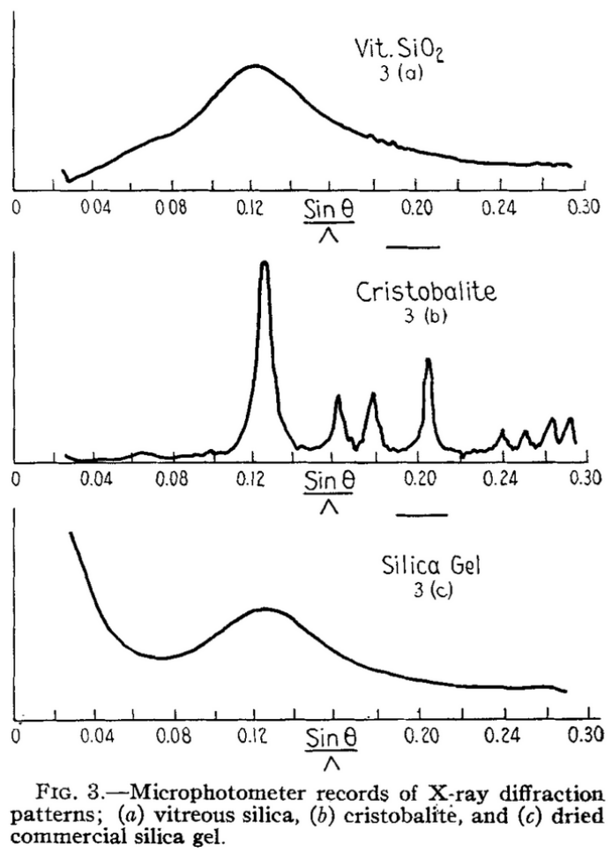
Glass consists of a continuous atomic network
Absence of small angle scattering
  Continuous structure without micro-voids and micro-crystals
Broad diffraction peak
  Size of ordered region < 8 Å (Scherrer equation)
  Unit cell size of cristobalite: 7.1 Å
Glass is NOT a collection of extremely small crystals
J. Am. Cer. Soc. 21, 49-54 (1938)

Slide 24
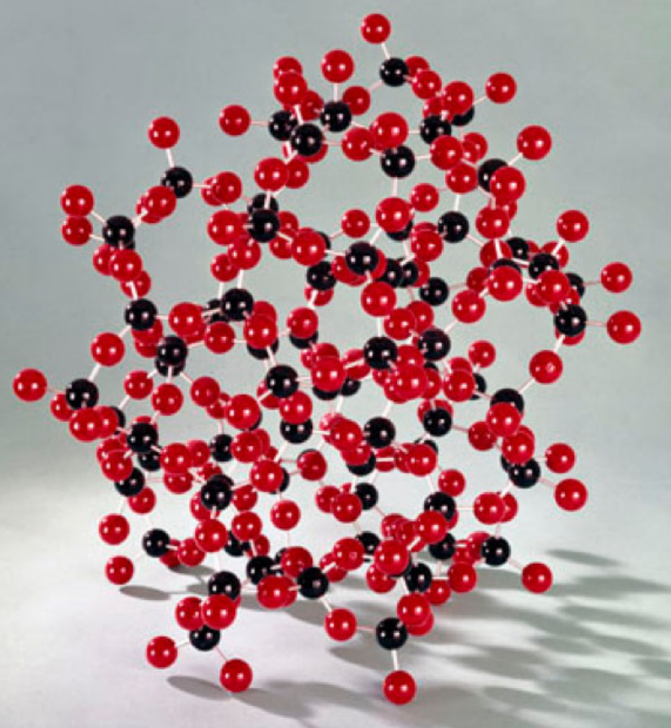
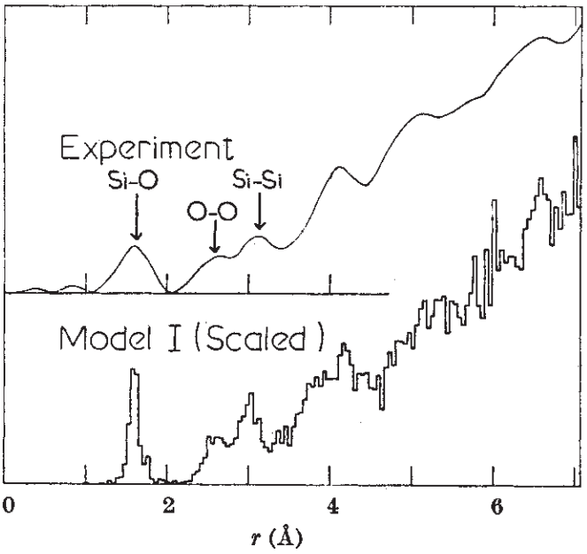
Random network model of silica glass (SiO₂)
Radial distribution function
Excellent agreement between XRD and ball-and-stick model constructed according to the random network model
Nature 212, 1353 (1966)
Now in the Science Museum, London

Slide 25
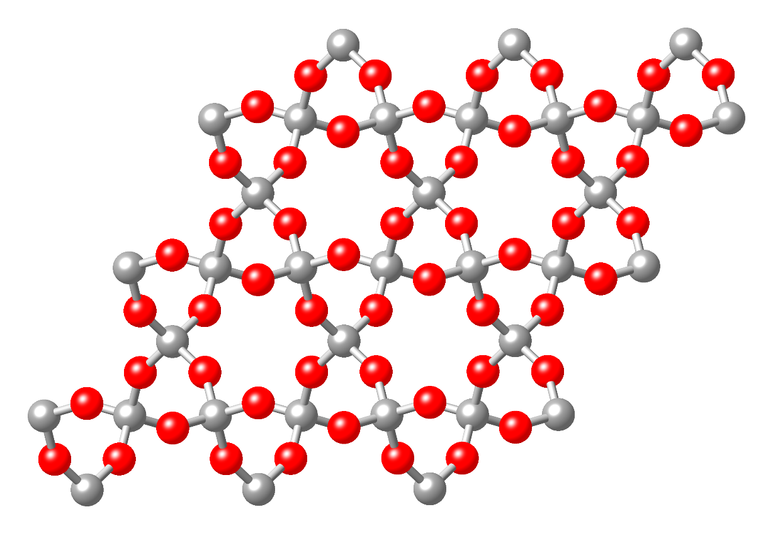
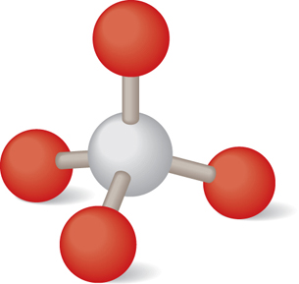
Direct atomic imaging of bilayer silica glass
O
O
O
Si
Si
O
2-D projection
Quartz crystal
Si-O tetrahedron

Slide 26
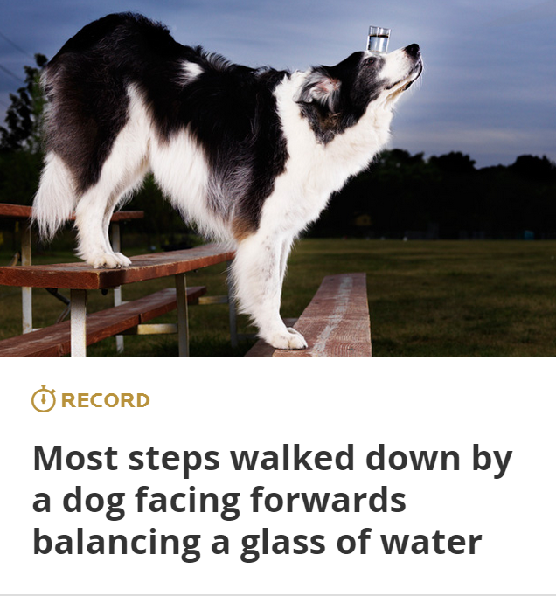
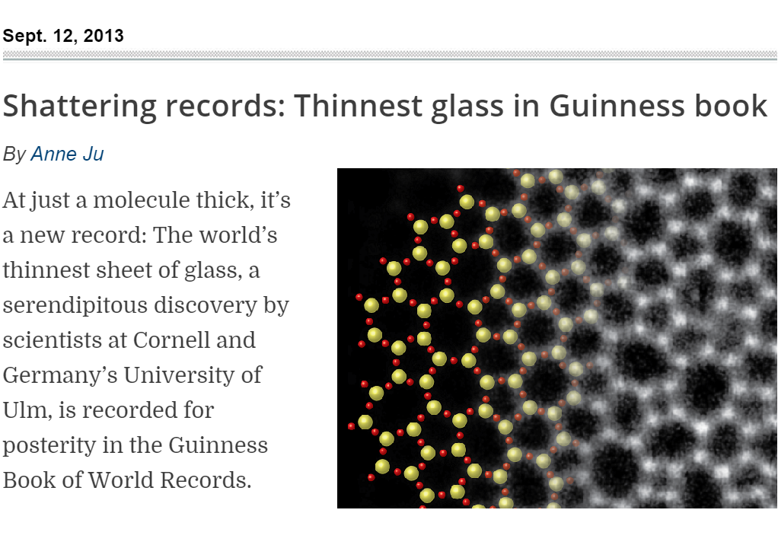
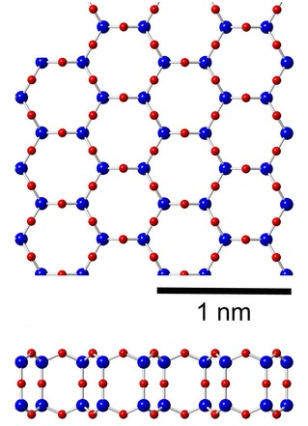
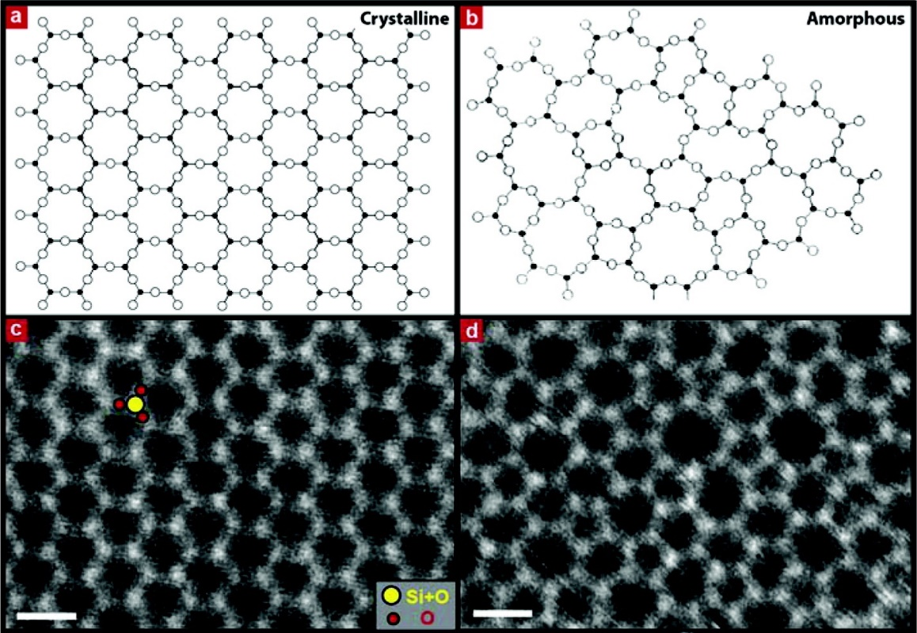
Direct atomic imaging of bilayer silica glass
STEM images of 2-D silica crystal and glass
Sci. Rep. 3, 3482 (2013)
Nano Lett. 12, 1081-1086 (2012)

Slide 27
Glass formation from liquid
V, H
When the system is kept in thermal equilibrium:
First-order liquid-solid phase transition
Discontinuity of extensive thermo-dynamic parameters (e.g., V and H)
Reversible process
Liquid
Melting / solidification
Crystal
T_{m}
T
Notes:
The enthalpy plot is generic but the V-T is not: note volume anomaly in silica glass

Slide 28
Glass formation from liquid
V, H
Supercooled liquid
Supercooled liquid transforms to the glassy state when crystallization is kinetically suppressed
Extensive variables remain continuous during glass transition
The glassy state is different from super-cooled liquid
T_{f} : Fictive temperature
Liquid
Glass transition
Glass
Crystal
T_{f}
T_{m}
T
Notes:
Slope change between liquid and solid: heat capacity or thermal expansion coefficient change

Slide 29
Glass formation from liquid
V, H
Supercooled liquid
Glasses obtained at different cooling rates have different structures
With increasing cooling rate:
V₁ < V₂ < V₃
Free volume increases
H₁ < H₂ < H₃
Configurational entropy increases
T_{f,1} < T_{f,2} < T_{f,3}
Liquid
Increasing
cooling rate
3
2
1
T_{m}
T

Slide 30
Glass formation from liquid
V, H
Supercooled liquid
Liquid
The heating curve never retraces the cooling curve during glass transition due to structural relaxation
T_{m}
T

Slide 31
What is amorphous solid (glass)?
A metastable solid with no long-range atomic order (and exhibiting glass transition)
Liquid: atoms do not have fixed positions; bonding constraints relax as temperature rises
Solidification
Melt quenching
Melting
Softening
Crystal: atoms arranged with both short range and long range order
Crystallization
Glass: atoms arranged with short range order but lack long range order
Amorphization (vitrification)

Slide 32
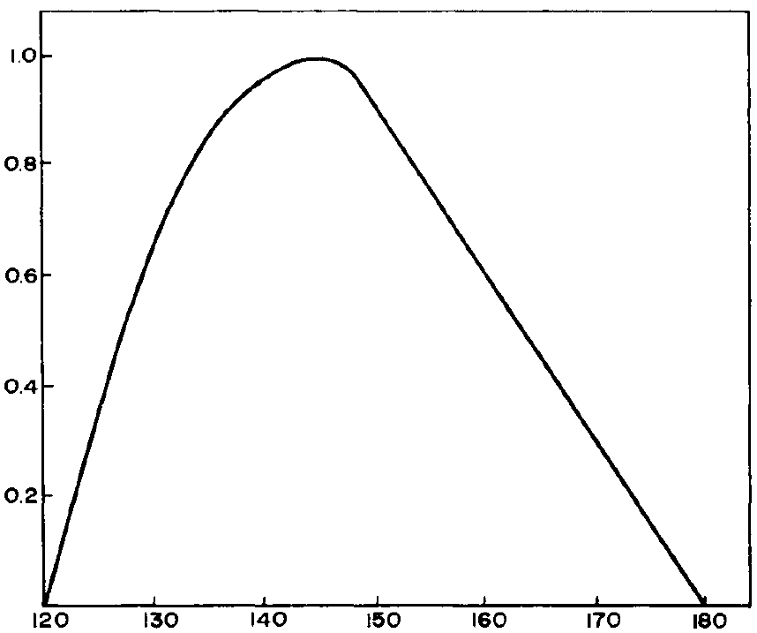
What is amorphous solid (glass)?
A metastable solid with no long-range atomic order (and exhibiting glass transition)
Si-O-Si bond-bending constraint is relaxed at the forming temperature of silica glass
Normalized distribution
Si-O-Si bond angle distribution in silica glass measured by XRD
J. Appl. Cryst. 2, 164 (1969)
144°: Si-O-Si bond angle in α-quartz
Si-O-Si bond angle in fused silica

Slide 33
Quantitative description of glass structure
Structural descriptions of amorphous materials are always statistical in nature
Pair distribution function (PDF): g(r)
  Consider an amorphous material with an average number density of atom given by:
  The number density of atoms at a distance r from an origin atom is given by
  When
  When
n : number of atoms V : material volume

Slide 34
PDFs of ideal (hard sphere) crystals vs. glasses
g(r)
1st coordination shell
2nd coordination shell
r
g(r)
1
r
0

Slide 35
Quantitative description of glass structure
Pair correlation function h(r)
Radial distribution function (RDF): J(r)
  J(r)dr gives the number of atoms located between r and r + dr away from the origin atom
  The area under the RDF curve gives the number of atoms
Reduced radial distribution function (rRDF): G(r)
Notes:
Beware that different books may use different terminologies

Slide 36
Summary
The amorphous state is metastable
Amorphous structures possess short-range order and lack long-range order
Amorphous materials can be obtained from liquid by melt quench
Melt quench is a continuous, irreversible process involving phase change
Glass properties depend on their thermal history
Supercooled liquid
V, H
Liquid
Glass
Crystal
T_{m}
T

Slide 37
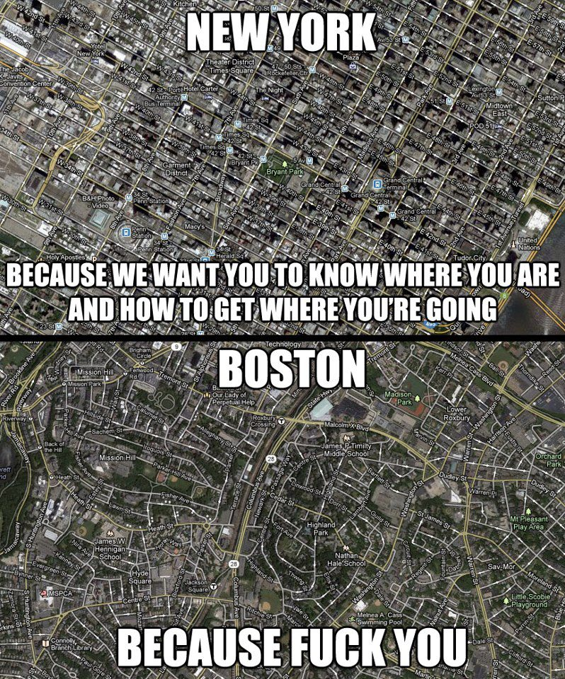
Crystalline vs. amorphous

Slide 38
Crystalline vs. amorphous

Slide 39
After-class reading list
Fundamentals of Inorganic Glasses
  Ch. 1 & 2
Introduction to Glass Science and Technology
  Ch. 1

