Slide 1

L2: Naming
Dina Katabi & Sam Madden
6.033 Spring 2014
http://web.mit.edu/6.033

Slide 2
Name Examples in Systems
csail.mit.edu | DNS name
128.30.2.121 | IP Address
dina | User name
dina@csail.mit.edu | Email address
R0 | x86 processor register
/mit/6.033/www/dp1.ps | File name
http://web.mit.edu/6.033/www/dp1.ps | URL
(617) 324-6027, x4-6027 | Phone number

Slide 3
Client-Server Example
public interface ShipInterface extends Remote {
public String ship(Integer) throws RemoteException;
}
public static void main (String[] argv) {
try {
ShipInterface srvr = (ShipInterface)
Naming.lookup("//amazon.com/Ship");
shipped = srvr.ship(“123”);
System.out.println(shipped);
} catch (Exception e) {
System.out.println (”ShipClient exception: " + e);
}
}

Slide 4


Slide 5
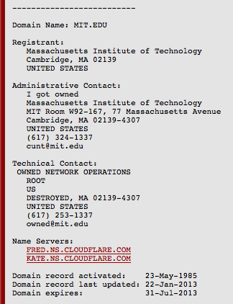

Slide 6
Summary
Names are pervasive in computer systems, used to connect modules together
To understand a naming system, think about:
  What's the syntax for names?
  What are the values?
  What is the name resolution algorithm?
  Where does the lookup context come from?

