Slide 1
Mission 2017
Panel Members

Slide 2
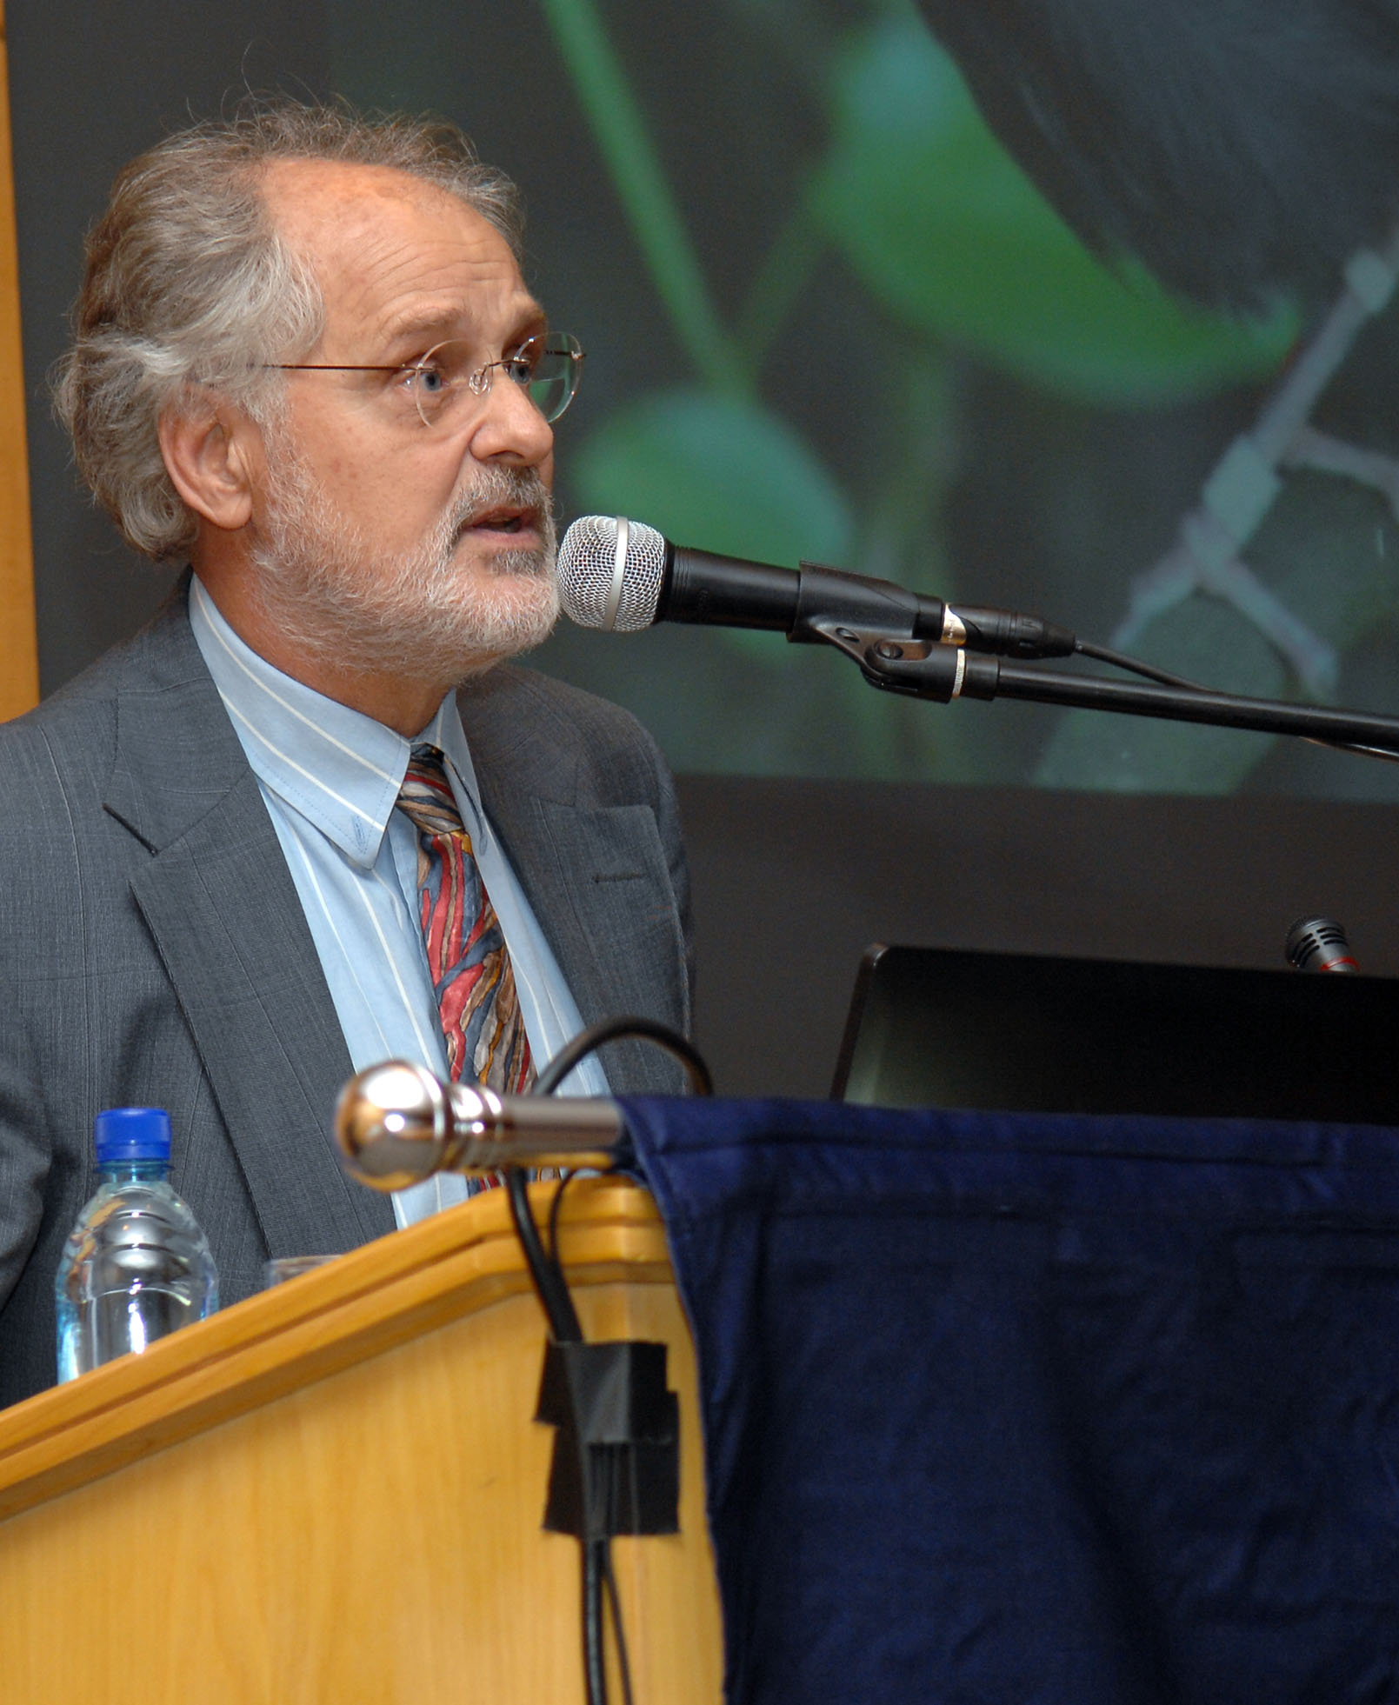
Professor Maarten de Wit
Nelson Mandela Metropolitan University
Founding and Science Director, Africa Earth Observatory Network
Chair of Earth Stewardship Science, Nelson Mandela Metropolitan University
Founding Director of AEON (Africa Earth Observatory Network), a trans-disciplinary research institute (www.aeon.org.za); and the transdisciplinary Earth Stewardship Research Institute at NMMU.

Slide 3
Prof. Maarten de Wit (con’t)
Research Interests:
  Economics of natural-resources and sharing of the ‘commons’
  Real costs of global pollution
  Geodynamics, tectonics, early earth processes
  The evolution of Africa and Gondwana;
  The origin of continents, life and mineral resources;

Slide 4
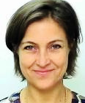
Julia Bucknall
Water Anchor, World Bank
Manager of Water, World Bank
  water supply
  sanitation
  agricultural water management
  hydropower
Masters in Environmental Policy and Planning, MIT

Slide 5
Julia Bucknall (con’t)
Past Work
Led water management projects in the Middle East, North Africa, Central Asia, Caucuses, Central Europe
Environmental Resources Management, with projects in Cambodia, Zimbabwe, Mexico, Honduras
Author of “Making the Most of Scarcity,” a publication about water in the Middle East and North Africa Region

Slide 6
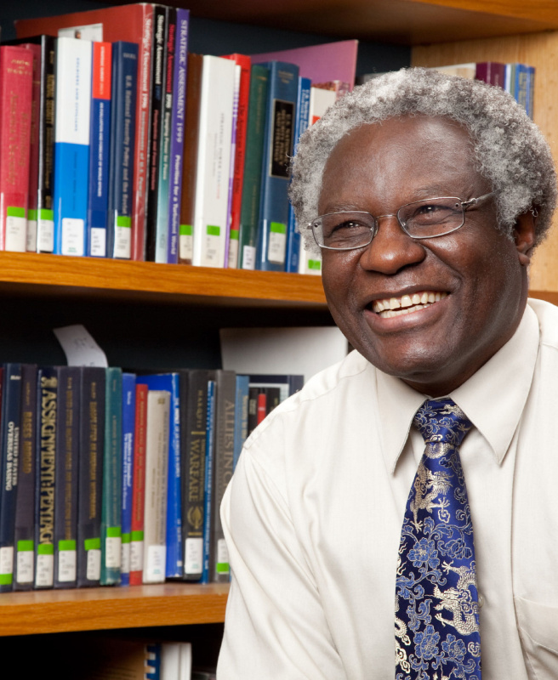
Professor Calestous Juma
John F. Kennedy School of Government, Harvard University
  Professor of the Practice of International Development
  Faculty Chair of the Innovation for Economic Development Executive Program
  Director; Science, Technology and Globalization Project and Agricultural Innovation in Africa Project

Slide 7
Prof. Calestous Juma (con’t)
Research Interests:
  biodiplomacy
  ecological jurisprudence
  technological innovation in sustainable development
  biotechnology
Recent Appointments, Awards
  Fellow, Royal Society of London
  Foreign Associate, US National Academy of Sciences
  Editor, International Journal of Technology and Globalization
  WWF International Board (2009-2012)
  Committee on Grand Challenges in International Development, US National Academy of Sciences (2011-2013)

