Slide 1
Mission 2014 GIS Workshop September 22, 2010
Daniel Sheehan
Senior GIS Specialist
MIT Libraries
dsheehan@mit.edu
gishelp@mit.edu
X2-1475

Slide 2
Outline for today
GIS Resources on campus
Looking at data in Arcgis
Data for the workshop
GIS workshop (to be completed by September 29)

Slide 3
GIS Resources On Campus
MIT GIS Lab
Located in Rotch Library, building 7 (second floor, off of Lobby 7 – technically in build 7A)
6 Windows PC with Arcgis and Google Earth Pro
Staffed Monday through Thursday afternoons 12:30 – 4:00PM and by appointment
Spatial Data Repository
37-312
22 Windows PC with Arcgis
You need Athena combination and ID card for entry

Slide 4
GIS staff at MIT
Anne Graham
Heather McCann
Jennie Murack
Daniel Sheehan
Lisa Sweeney
Contact us at gishelp@mit.edu or stop in GIS Lab during lab hours

Slide 5
MIT Spatial Data Repository
Search Tools
Geoweb, a web interface to 2,000 layers at MIT, 1,000 layers at MASSGIS, and 8,000 layers at Harvard
MIT licensed data are certificate protected
Some Harvard layers are restricted to Harvard users
Layers can be drawn on the web interface or downloaded to local drives (in zipped folder)
Before the end of the semester, paper maps will be searchable

Slide 6
MIT Spatial Data Repository
Search Tools (continued)
Arcgis desktop version searches only MIT data
Data is downloaded to your Arcgis project and can easily be saved to local drives

Slide 7
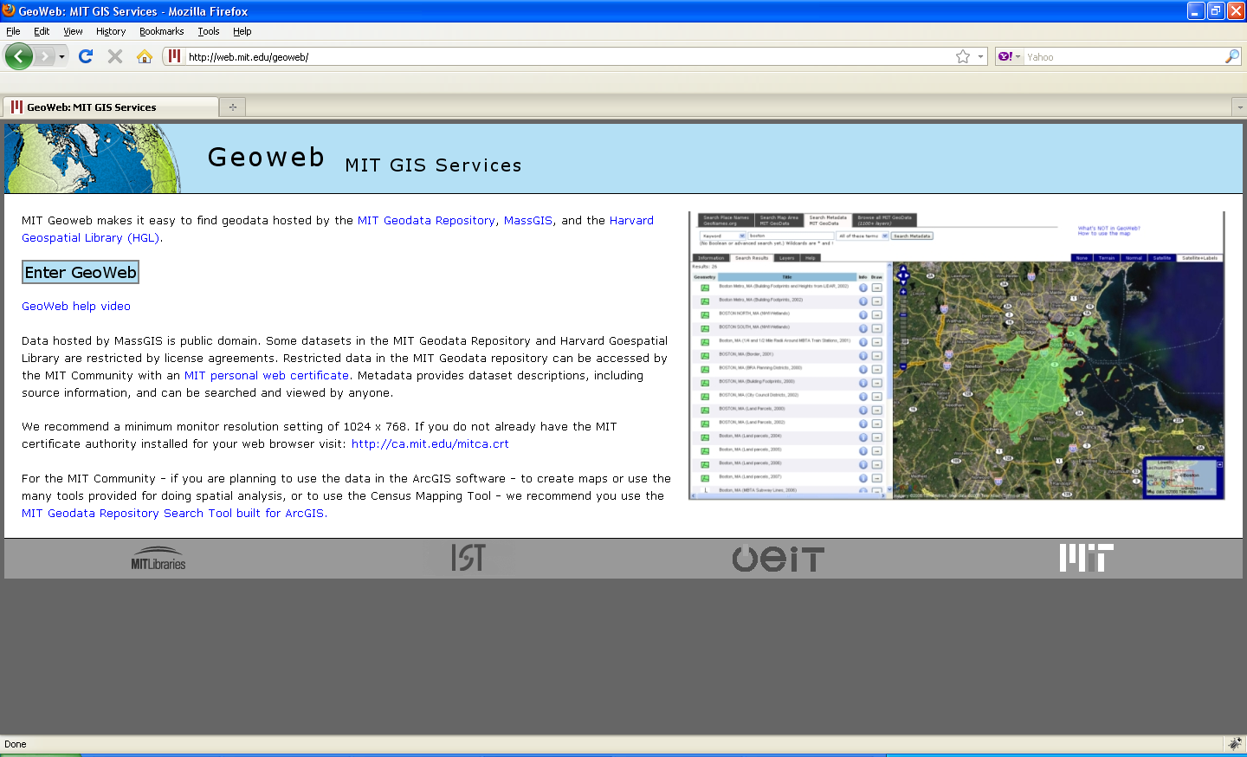
MIT Geoweb: web.mit.edu/geoweb

Slide 8
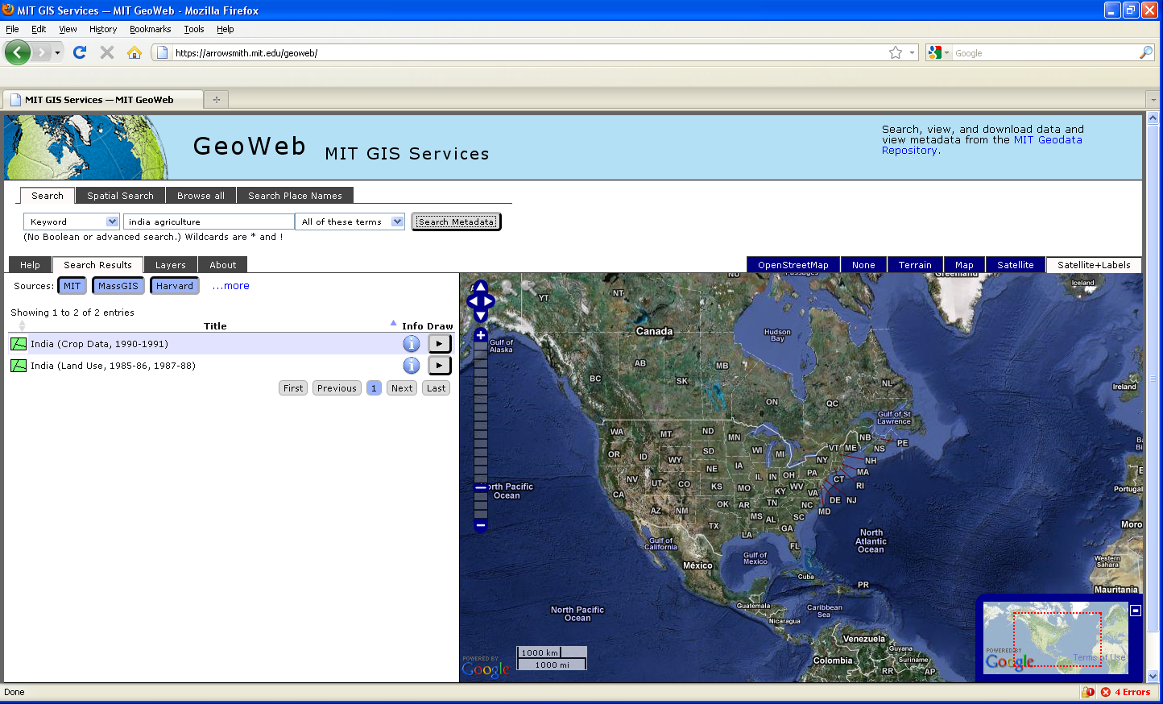
Geoweb: Keyword Search

Slide 9
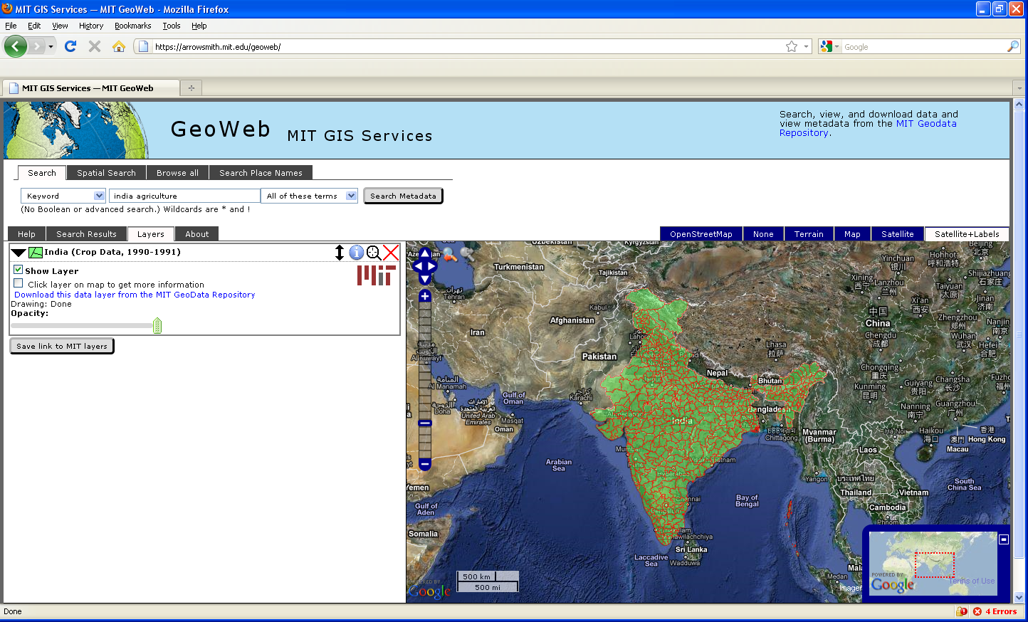
Geoweb: Search Results

Slide 10
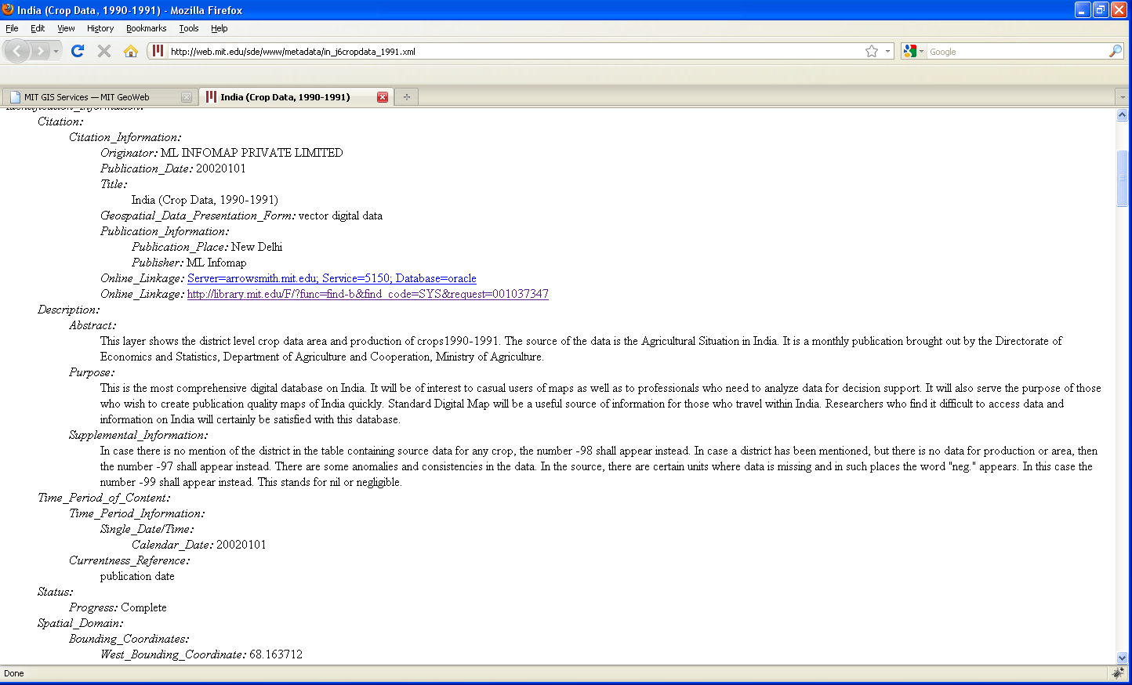
Geoweb: Metadata

Slide 11
Arcgis Desktop Software
Data Display
No data exists in software, you need to find and add data
Data Processing
Simple Cartography
Export maps to finish in Photoshop, etc

Slide 12
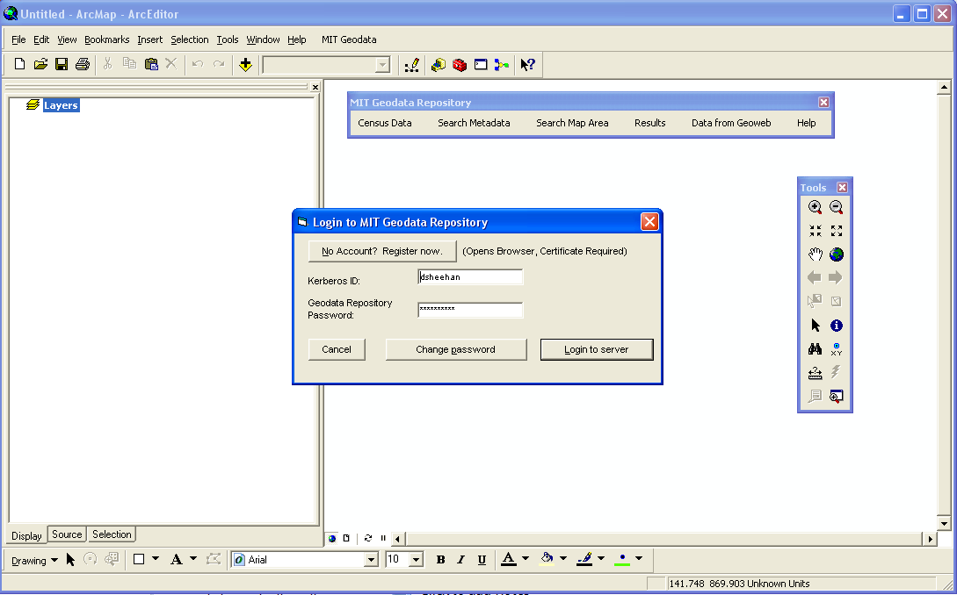
MIT Geodata Repository Login

Slide 13
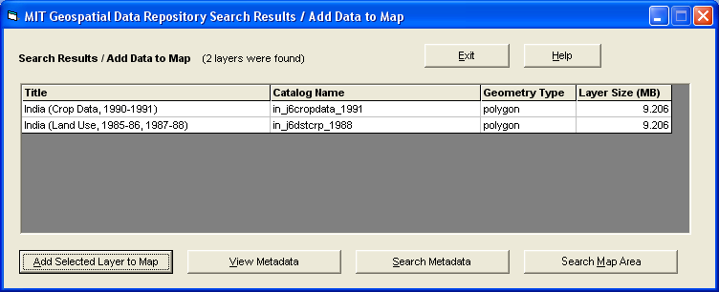
Metadata Search and Results

Slide 14
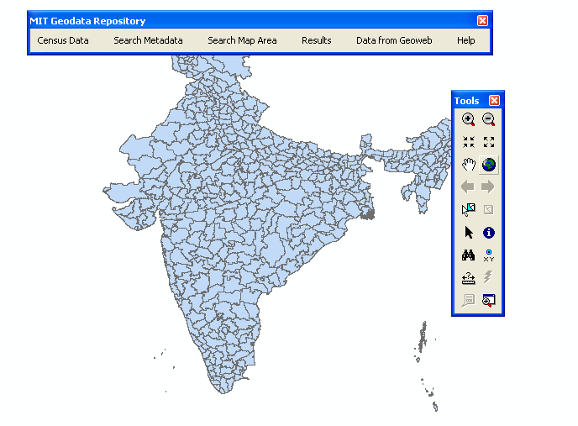
Data Added to Map

Slide 15
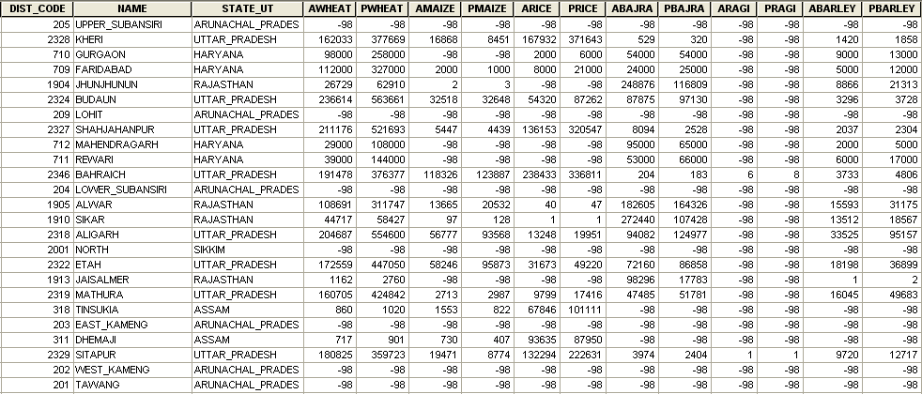
Attributes of Districts

Slide 16
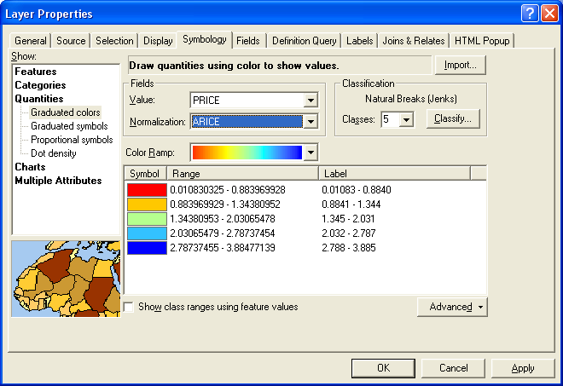
Symbolizing the data

Slide 17
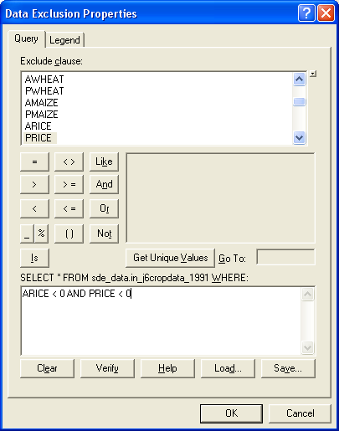
Exclude Missing Data

Slide 18
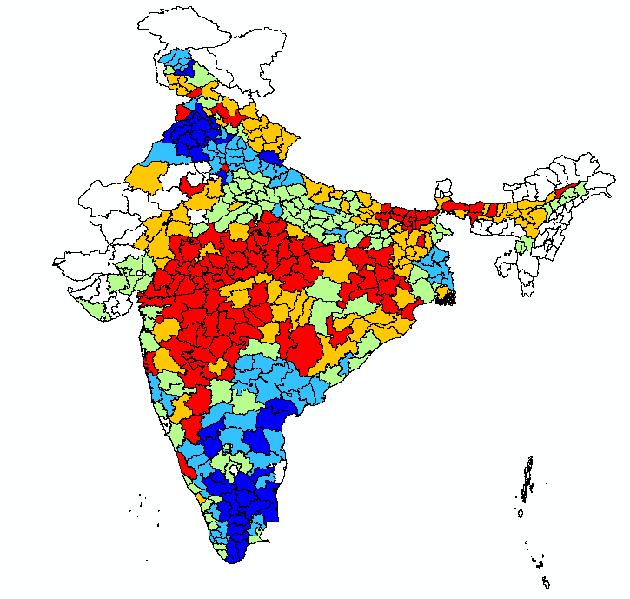
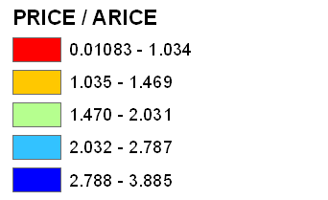
A Readable Map?

Slide 19
Getting the Software for your personal machine
Getting Arcgis: https://web.mit.edu/ist/products/vsls/forms/esri.html
Download the search tool:
http://libraries.mit.edu/gis/data/searchdll/
http://libraries.mit.edu/gis/data/repository/install_geodata_census.html

Slide 20
Getting a repository account for Arcgis
http://libraries.mit.edu/gis/data/repository.html
You need a certificate on your machine to open an account!
Use a password other than your Athena/email password. Must be at least 8 characters starting with a letter.

Slide 21
GIS Workshops
Mandatory GIS workshops
Should take you about 1 hour
You will use Arcgis, the most common desktop GIS. MIT has a site license for this software.
You will use 1KM resolution land cover data to indentify locations of agricultural lands in China and their proximity to transportation (railroads)

Slide 22
Data for the workshop
United States Geological Survey 1KM Global Land Cover Characteristics database
http://edc2.usgs.gov/glcc/glcc.php
Cell based data with a single value for each 1km x 1km area
Many areas have multiple land covers:
161 Cropland (Mixed Row Crops) with Woodland
162 Cropland (Grass Seed, Small Grains) with Mixed Woodlands
Notes:
http://edc2.usgs.gov/glcc/glcc.php

Slide 23
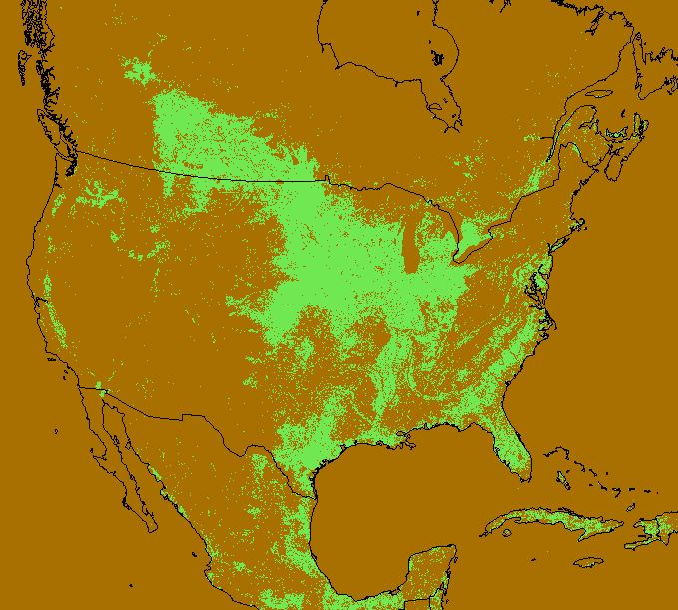
North America – Cropland

Slide 24
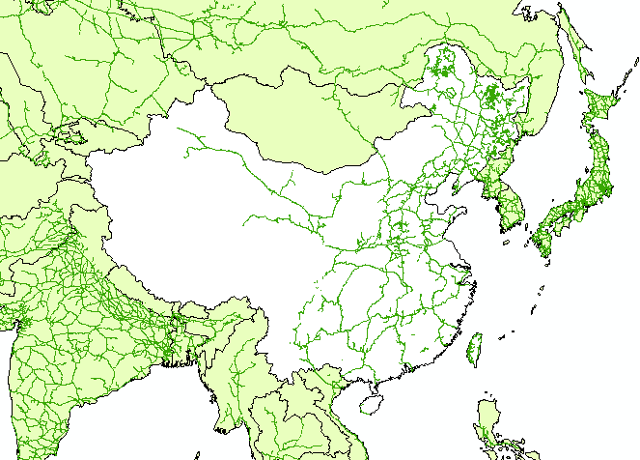
Railroads in China and Vicinity

Slide 25
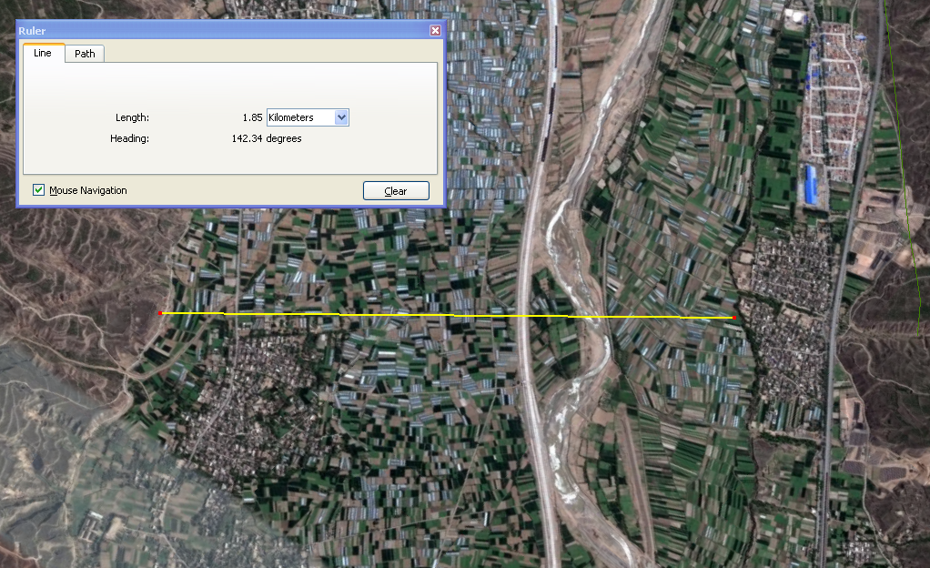
Agricultural Lands in China
From Google Earth

Slide 26
Workshops – when and where
Schedule time on Thursday (9/23) between 9AM and 5PM except 11AM-noon
Workshops on Friday (9/24) in DIRC 10AM-2PM (instructor is Anne Graham)
Schedule time on Monday (9/27) between 9AM and 5PM except
Workshop on Monday (9/27) in DIRC 7PM-8:30PM (instructor is Jennie Murack)

Slide 27
Workshops – when and where
Schedule time on Tuesday (9/28) between 9AM and 5PM
Workshop on Tuesday (9/28) in DIRC 7PM-8:30PM (instructor is Daniel Sheehan)
You need to contact Daniel Sheehan by email (dsheehan@mit.edu) to schedule time or reserve a spot for any of the workshops. Workshop limit is 20 participants.

Slide 28
Workshops – when and where
Workshops will be either in:
DIRC (where listed): 14N-132 (enter building 14 at the Music Library and go right, DIRC is on your right)
37-312 (You will need the Athena combination, type “tellme combo” on any Athena computer, and your MIT ID for entry)
GIS Lab, Rotch Library, building 7

Slide 29
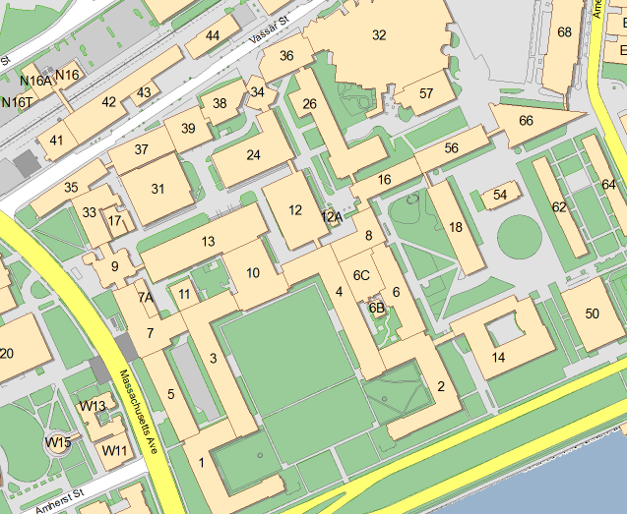
Workshop locations

Slide 30
Workshops – pick one!
Pick top 3 choices and send to Daniel Sheehan
I will send email with time and place for the workshop
Send email to dsheehan@mit.edu by the end of the day, Wednesday September 22 (today)

Slide 31
For the future
Data formats that work in GIS …
shapefiles
arcinfo coverages and grids
jpeg
tiff and geotiff
Several other image formats with small fixes
CAD (with conversions)
CSV files with a unique ID for specific geographic regions (country codes or province names)

